Slide 1
Malaria Cell Detection
Niel Parekh, Sai Charan B, Satya Bharati K

Slide 2
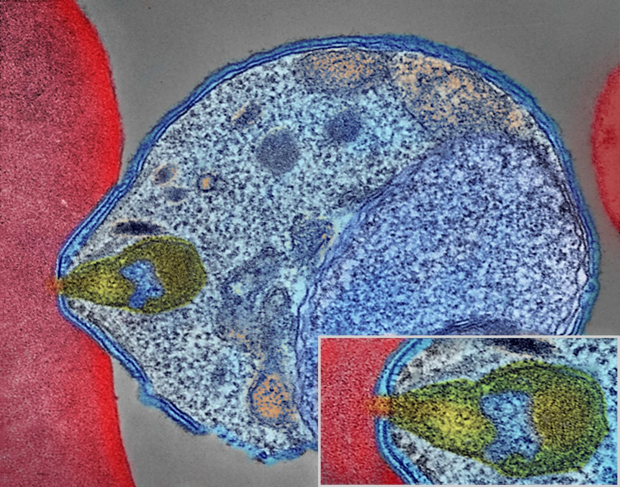
What is Malaria
Malaria is a serious and sometimes fatal disease caused by a parasite that commonly infects a certain type of mosquito which feeds on humans. People who get malaria are typically very sick with high fevers, shaking chills, and flu-like illness.

Slide 3
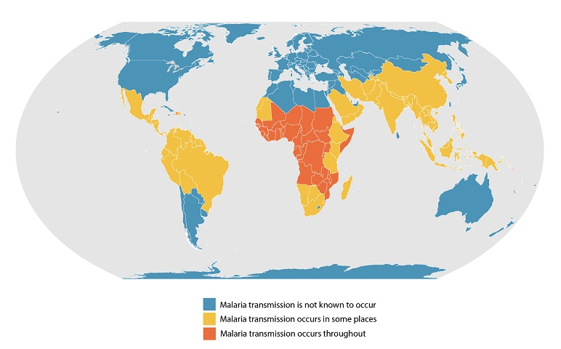
Worst affected areas
Malaria has wreaked havoc across the globe especially in sub-saharan Africa and rural parts of South-East Asia that do not have access to proper healthcare facilities.

Slide 4
Motivation
We chose this topic as of the biggest problems faced by these regions is lack of medical facilities. Lack of testing facilities often leads to no diagnosis or even the wrong diagnosis. This is detrimental to the people living in those regions. To tackle this we aim to create a lightweight system that identifies malaria cells in the blood sample of a patient. The aim is to be able to run the software on light hardware and not too many hardware resources.

Slide 5
Existing solutions
There have been several attempts at solving this problem of detecting malaria cells from a given cell sample.There are 2 main approaches. The first one being segmenting 2 the image to extract the cells first and the second would be to run the CNN directly on the image. The segmentation was done with an open source module known as CellProfiler. For the CNN a Faster R-CNN was used however reducing accuracy.

Slide 6
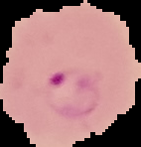
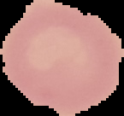
Dataset
Dataset being used is available on kaggle :
https://www.kaggle.com/iarunava/cell-images-for-detecting-malaria
Infected cell
Uninfected cell

Slide 7
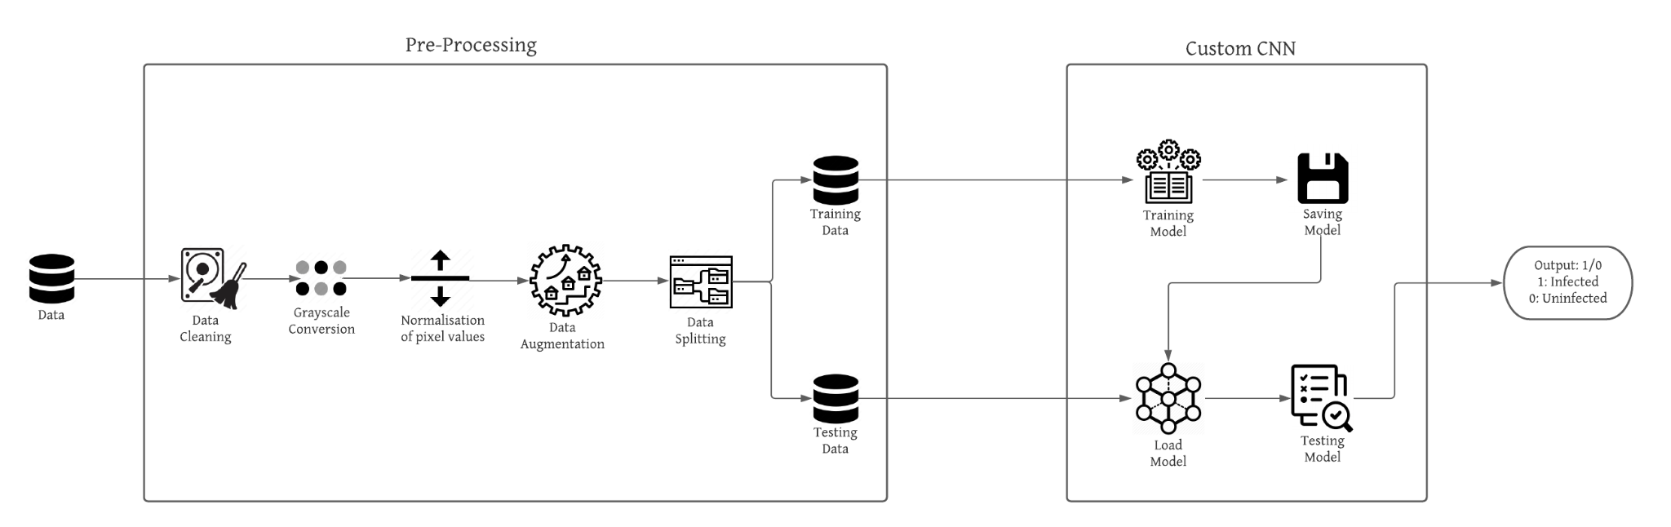
What we plan to do
We plan to first run some pre-trained models on the dataset to see if any of them give us good results and and not too computationally expensive after which we will make our own CNN and compare it with the previous results obtained from the pre-trained models.

Slide 8
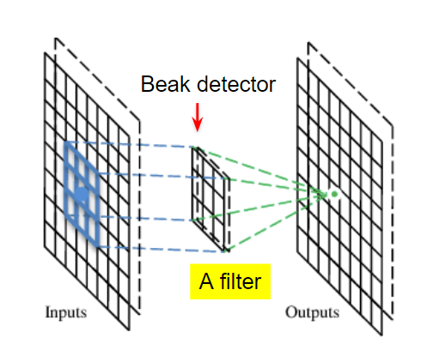
Convolutional Neural Network
A Convolutional neural network (CNN) is a neural network that has one or more convolutional layers and are used mainly for image processing, classification, segmentation and also for other auto correlated data.
A convolution is essentially sliding a filter over the input. Rather than looking at an entire image at once to find certain features it can be more effective to look at smaller portions of the image.

Slide 9
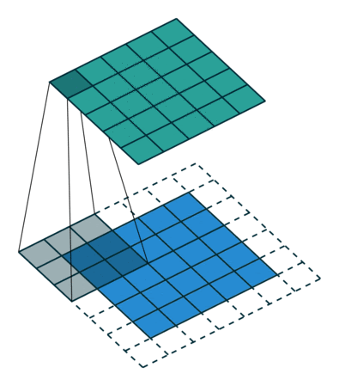
Padding
Padding is a term relevant to convolutional neural networks as it refers to the amount of pixels added to an image when it is being processed by the kernel of a CNN. For example, if the padding in a CNN is set to zero, then every pixel value that is added will be of value zero.
For a gray scale (n x n) image and (f x f) filter/kernel, the dimensions of the image resulting from a convolution operation is (n – f + 1) x (n – f + 1).
For example, for an (8 x 8) image and (3 x 3) filter, the output resulting after convolution operation would be of size (6 x 6).
Padding is simply a process of adding layers of zeros to our input images so as to avoid the problems mentioned above

Slide 10
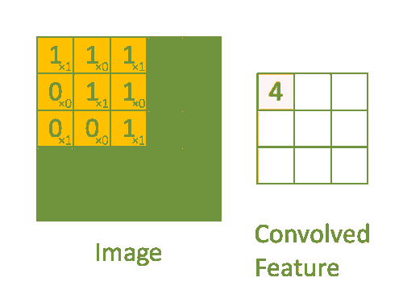
Convolutional Operation

Slide 11
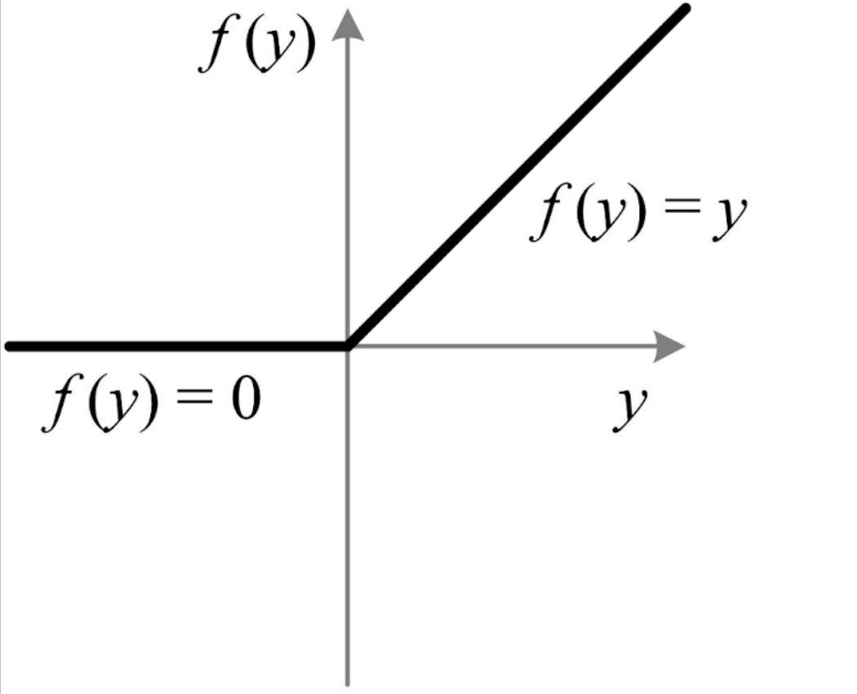
Activation Function: ReLU
These feature maps must be passed through a non-linear mapping. The feature maps are summed with a bias term and passed through a non-linear activation function: ReLu. The purpose of the activation function is to introduce non-linearity into our network because the images are made of different objects that are not linear to each other so the images are highly non-linear. Other versions of ReLU includes PReLU and leaky ReLU

Slide 12

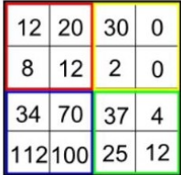
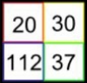
Max-Pooling and how it works
Max pooling returns the maximum value from the portion of the image by the Kernel. It also performs as a Noise Suppressant. It discards the noise activations all together and also performs de-noising along with dimensionality reduction

Slide 13
Pre-trained models
We run 3 pre-trained models on the dataset.
Transfer learning implemented.
Models :
VGG19
ResNet50
InceptionV3

Slide 14
VGG19
Has been trained on millions of image samples
Input is a 224*224 RGB image
19 weighted layers deep (16 Convolutional layers, 5 pooling layers)
Max Pooling window 2 * 2 pixels. Stride 2
ReLU to introduce non linearity so that model can classify better
3 Fully connected layers at the end

Slide 15
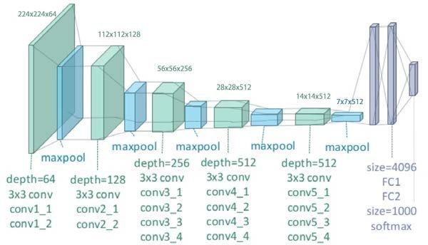

Slide 16
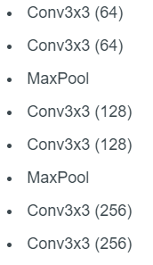
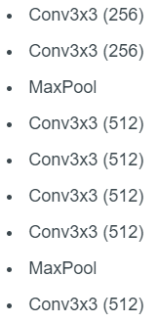
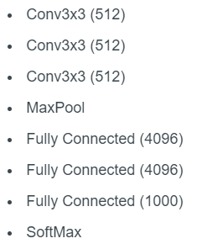

Slide 17
ResNet50
Variant of the ResNet model
48 Convolutional layers, 1 Maxpool and 1 average pool layer
3.8 x 10^9 floating point operations
Max pooling with also a stride size of 2
Earlier variants : ResNet 34 (older, outdated)

Slide 18
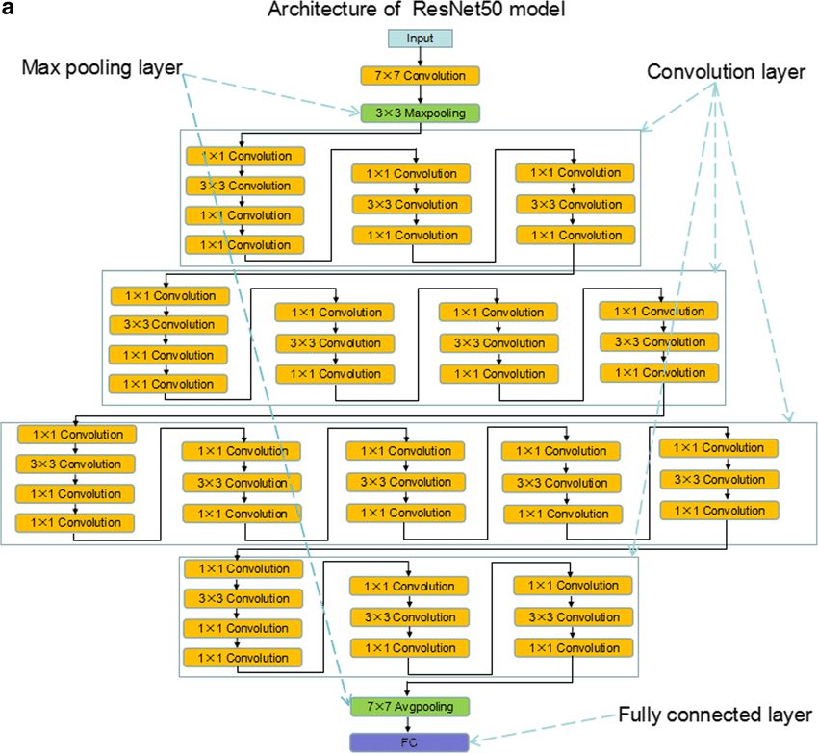

Slide 19
InceptionV3
Variant of the Inception family of models
Greater than 78% accuracy on ImageNet dataset
More efficient when compared to VGG
48 layers deep
Trained on over a million images.
Can classify into 1000 object categories.

Slide 20
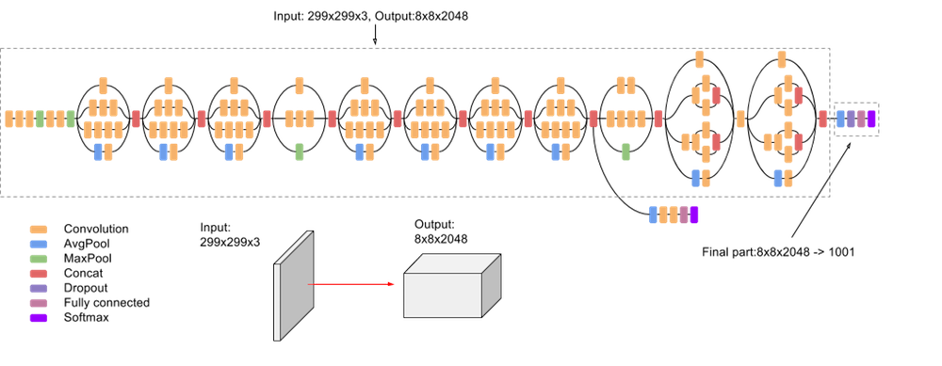

Slide 21
Our Custom Model
We aim to make a CNN model that is computationally efficient and can run on limited hardware.
For this, we utilize the concept of depthwise separable convolutions.
We aim to make a CNN that gives us good results, while making sure that it is not computationally expensive.
As a result, we try to minimize the number of parameters.

Slide 22
Depthwise Separable Convolutions
Depthwise separable convolution splits a kernel into 2 separate kernels that do two convolutions.
One is depthwise convolution
Another is pointwise convolution
This tends to take into account each channel, giving a higher accuracy while also being efficient.

Slide 23
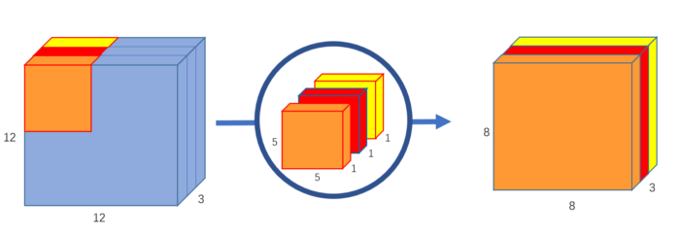
Depthwise Convolution
Kernel is 5x5x1. Image is 12x12x3.
Each kernel iterates 1 channel of the image. Hence we get 8x8x1 image from each kernel.
Stacking the images from each kernel, we get a 8x8x3 image.

Slide 24
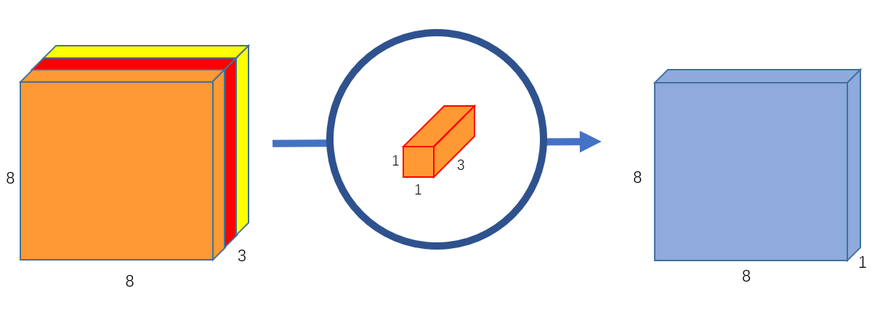
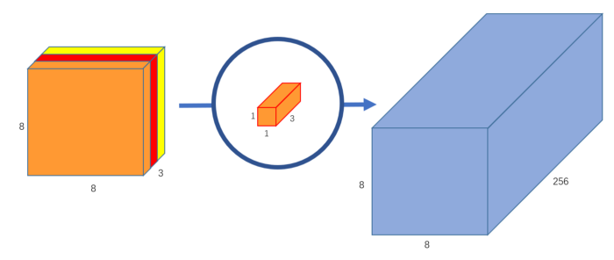
Pointwise Convolution
Kernel is 1x1x3. Outputs 8x8x1 image.
256 of these kernels are used.
Stacking them all on top of each other results in a 8x8x256 image

Slide 25
Why use depthwise? How does it work?
The number of multiplications the computer has to do in the original convolution. There are 256 5x5x3 kernels that move 8x8 times. That’s 256x3x5x5x8x8=1,228,800 multiplications.
In the depthwise convolution, we have 3 5x5x1 kernels that move 8x8 times. That’s 3x5x5x8x8 = 4,800 multiplications. In the pointwise convolution, we have 256 1x1x3 kernels that move 8x8 times. That’s 256x1x1x3x8x8=49,152 multiplications. Adding them up together, that’s 53,952 multiplications.
52,952 is a lot less than 1,228,800. With less computations, the network is able to process more in a shorter amount of time.

Slide 26
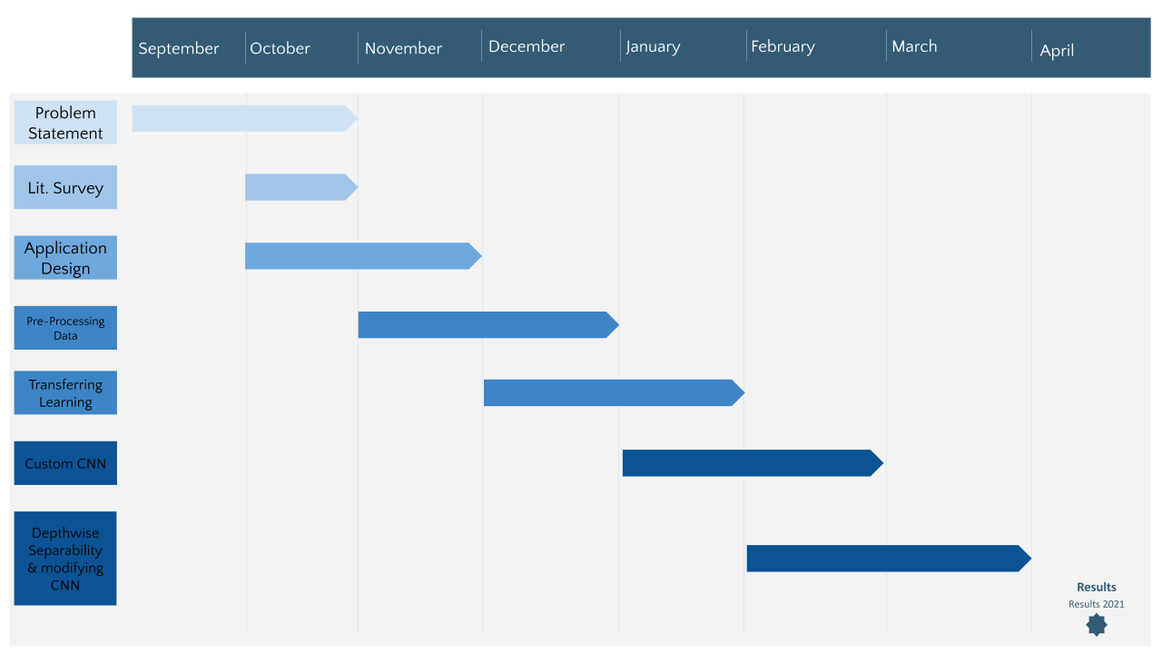
Timeline

Slide 27
Conclusion and possible work
Hence, we aim to develop a lightweight, computationally efficient CNN that can be implemented in impoverished regions easily.
Possibilities : We will look into running this CNN on our Android phones, as it is comparable to the lower end of the computational spectrum.
We are not sure if this can be implemented, since there are lots of dependencies that won’t work on Android. But we will try to implement it.

